Slide 1
Destiny Discover and DISCUS
Notes:
Caitlin Creagan- Media Specialist- Andrew Jackson High School- caitlin.creagan@lcsdmail.net
This is a presentation for Destiny Discover and DISCUS.
Slides 8-17 pertain to DISCUS. English II Pre-AP researches Opposing Viewpoints at Andrew Jackson High School. (Dress Code, School Shootings, Minimum Wage, Animal Experimentation, ADD/ADHD, obesity, etc.). This semester I showed them how to use the Mind Map on Credo Reference to focus their project, and how to download the article into their Google Drive, I also went over Opposing Viewpoints and how to sign in with Google (creating a folder in the drive for the articles) and finally Points of View (sharing the article and then e-mailing the article to their Google account). I also included how to find citations and emphasized in Credo that students need to select MLA because this database goes automatically to APA citation.
There is a link to DISCUS on the library webpage as well as the library catalog.

Slide 2
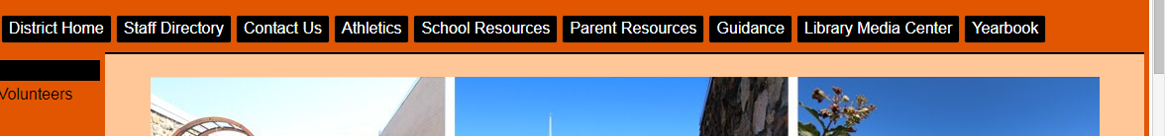
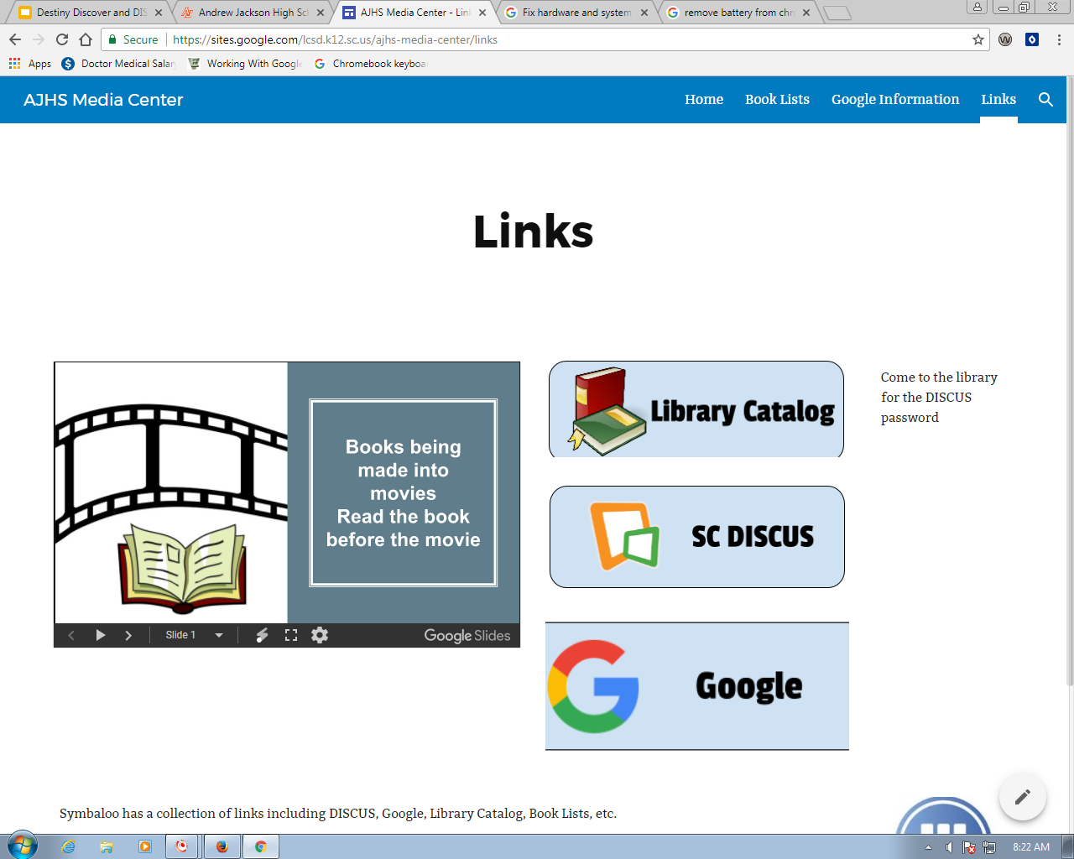
School Website
Library Media Center-Links-Library Catalog

Slide 3
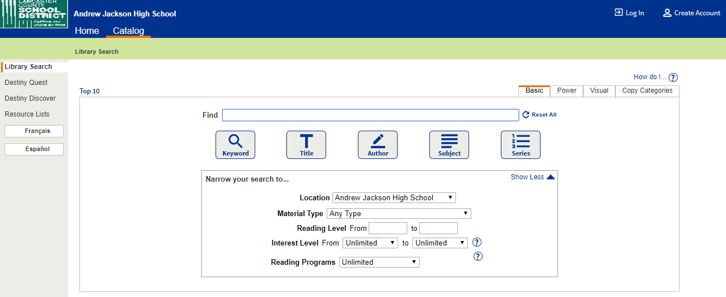
Choose DESTINY DISCOVER

Slide 4
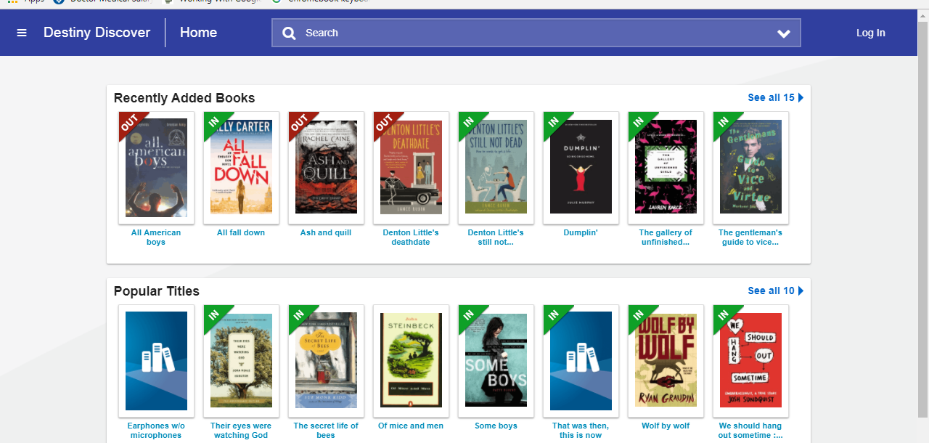
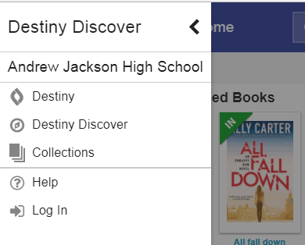
Click on the lines on the upper left corner
Choose COLLECTIONS

Slide 5
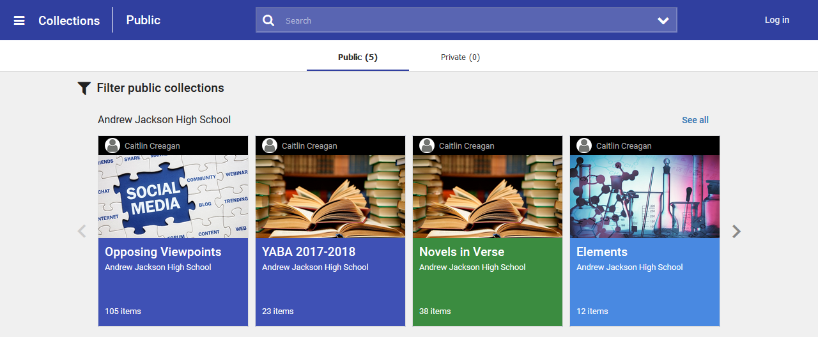
Opposing Viewpoints

Slide 6
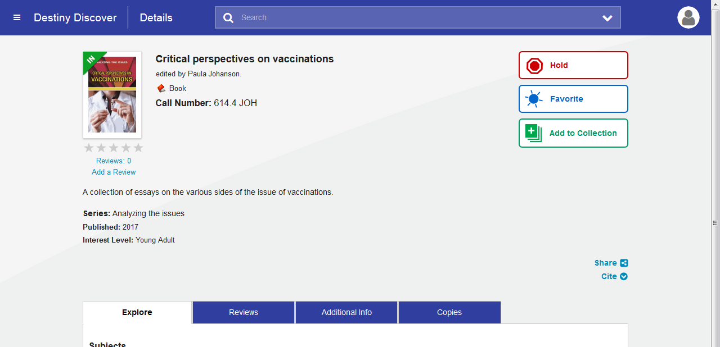
Click on a book
Options-Share and CITE

Slide 7
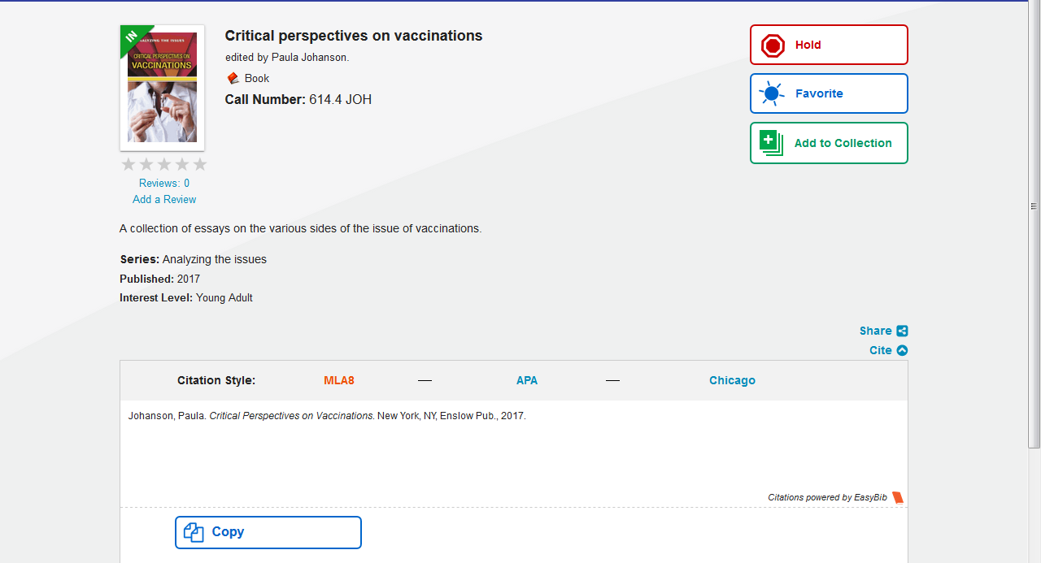
Citations may not be completely correct
Choose MLA8

Slide 8

DISCUS

Slide 9
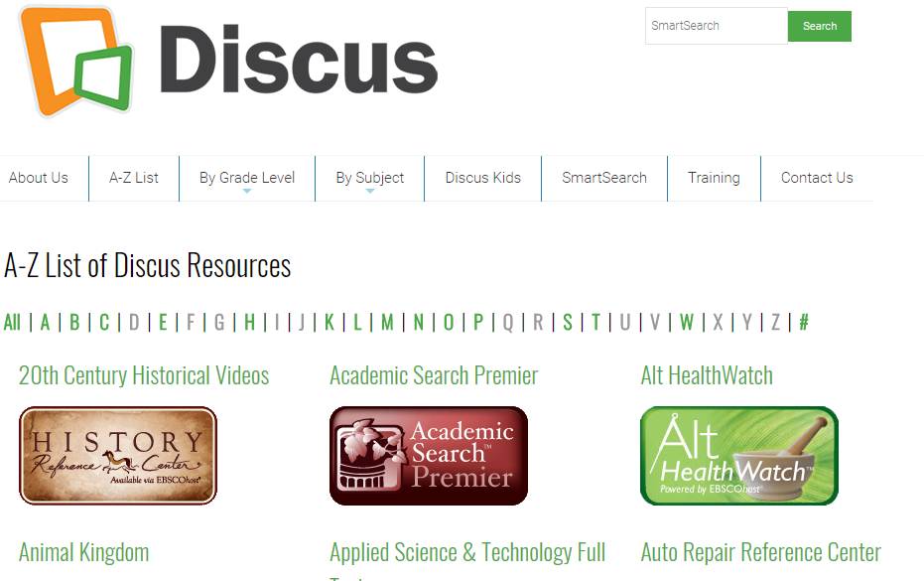
DISCUS A-Z List

Slide 10
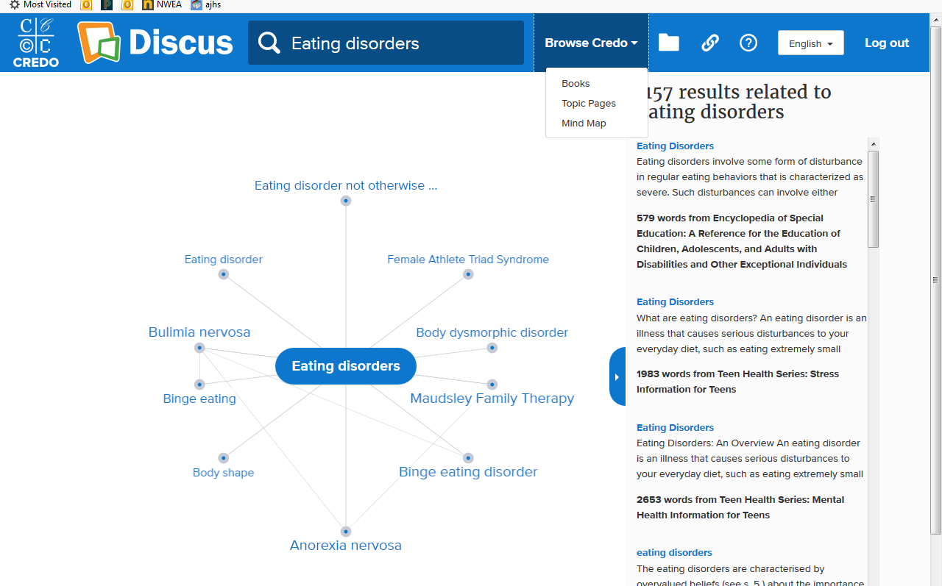
A-Z List Credo Reference Center
Put in topic-choose “MIND MAP” (pulls other related topics)

Slide 11
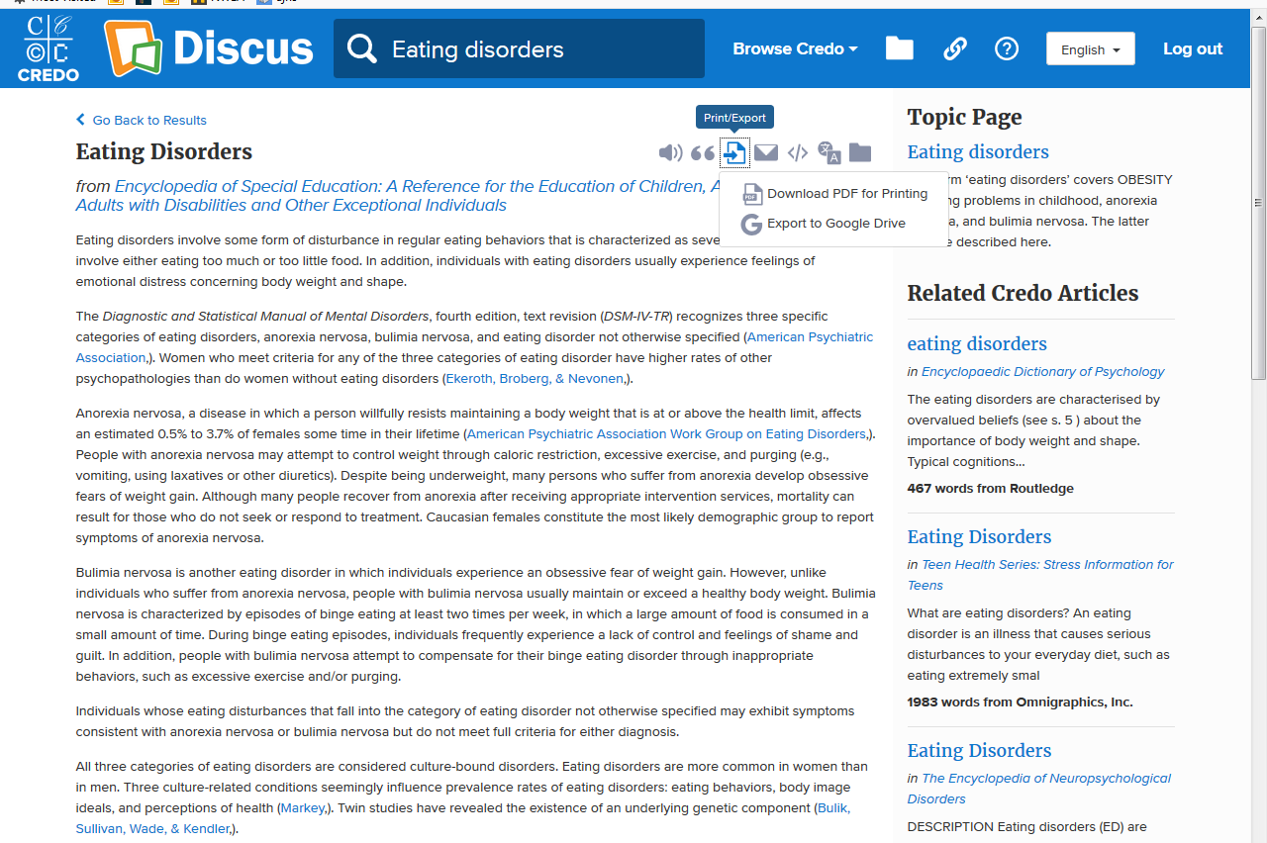
Export TO GOOGLE DRIVE

Slide 12
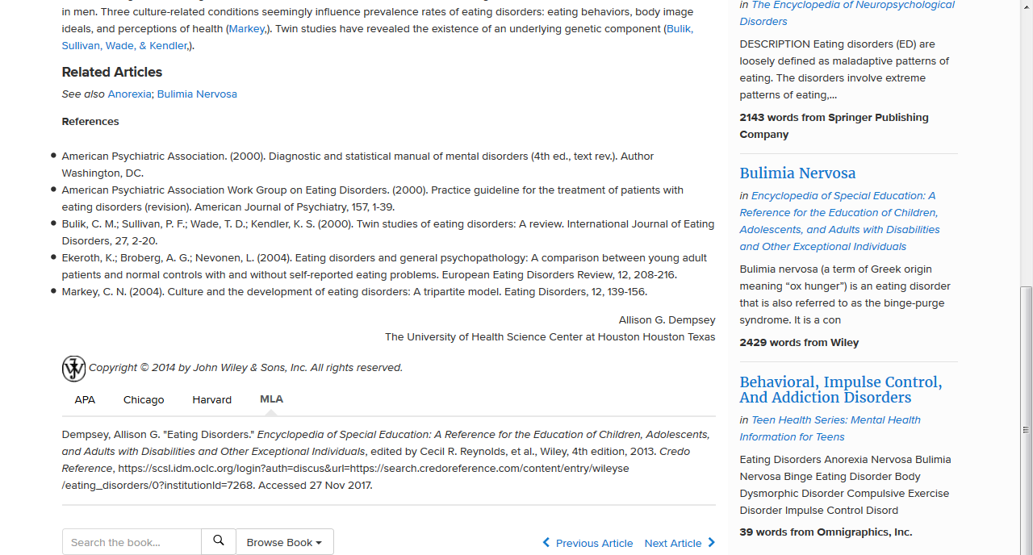
CITATION-Scroll down to the bottom-choose MLA

Slide 13
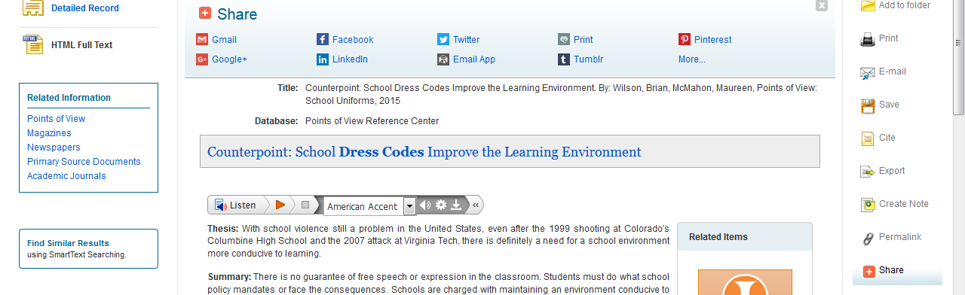
Points of View (Share-Choose gmail and e-mail it) If this doesn’t work, e-mail me or Mrs. Couch at outlook e-mail @lcsdmail.net

Slide 14
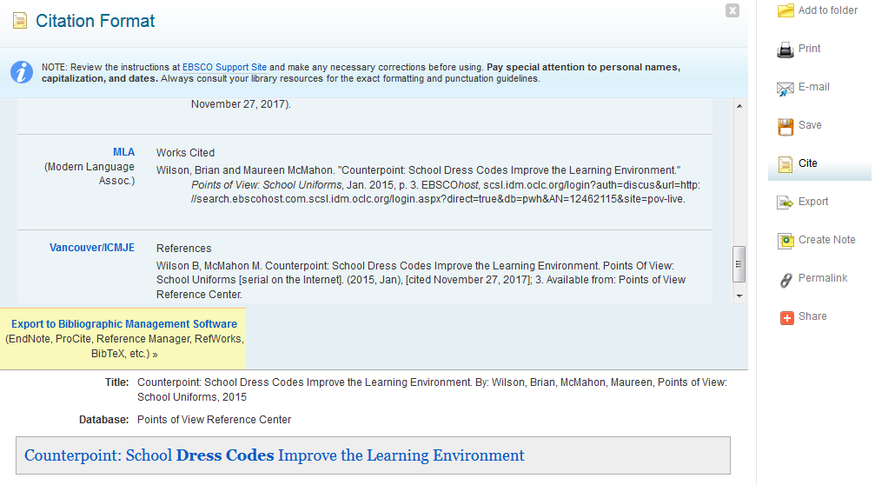
Points of View- Cite (scroll to MLA)

Slide 15
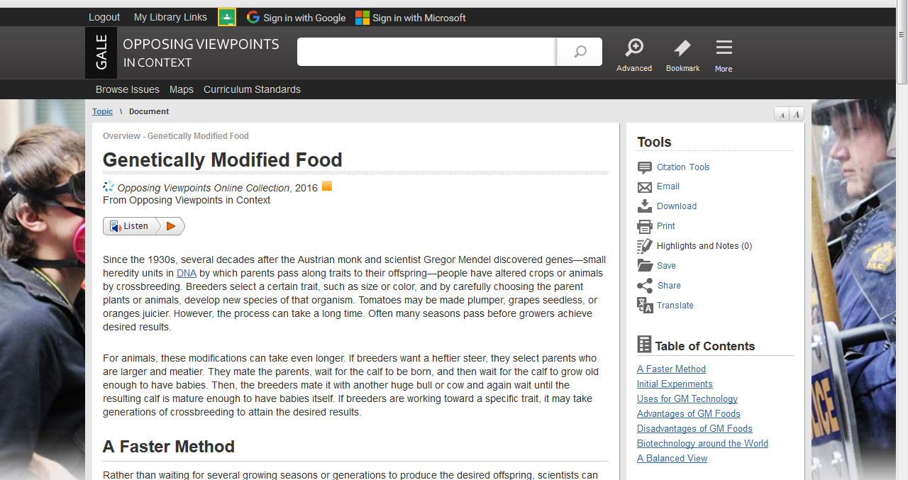
Opposing Viewpoints
Sign in With Google

Slide 16
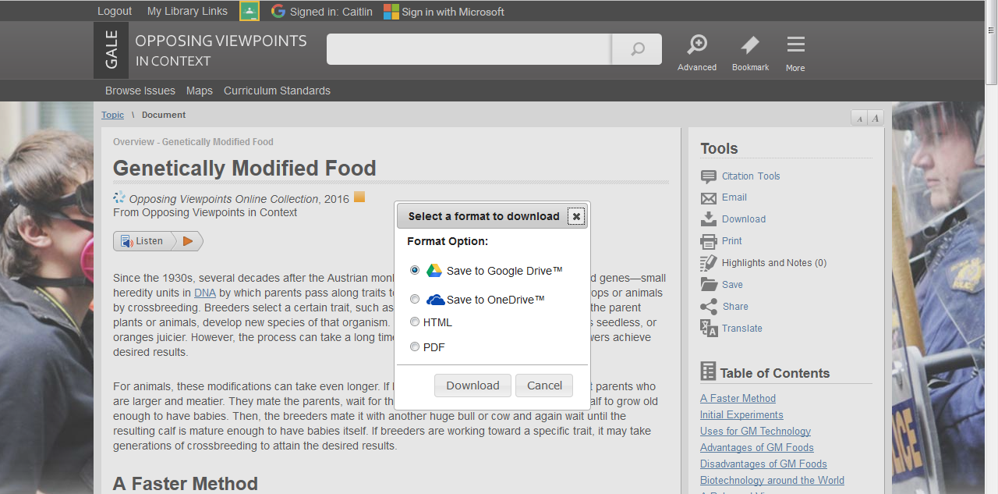
Download and Save to Google Drive

Slide 17
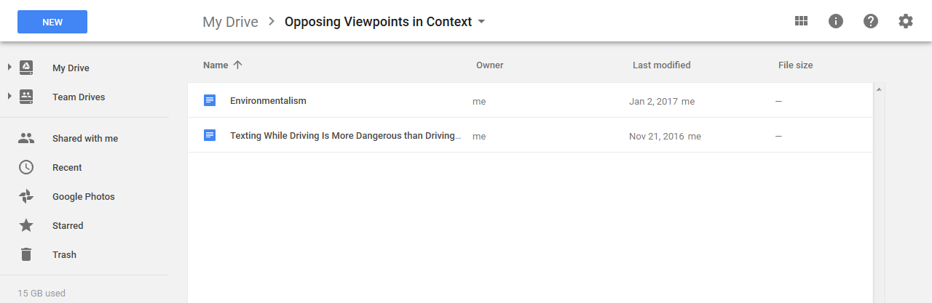
Folder is created in your Google Drive
Titled: Opposing Viewpoints

Slide 18
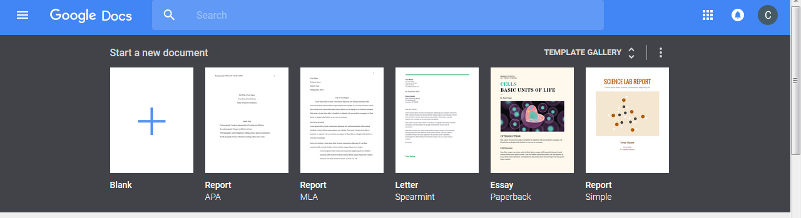
MLA Paper in Google
Docs
If it doesn’t show hit template gallery

